Slide 1
EXTREME PROGRAMMING
Integrantes:
Julian David Ortega Castillo
Johan Sebastian Sierra Torres

Slide 2
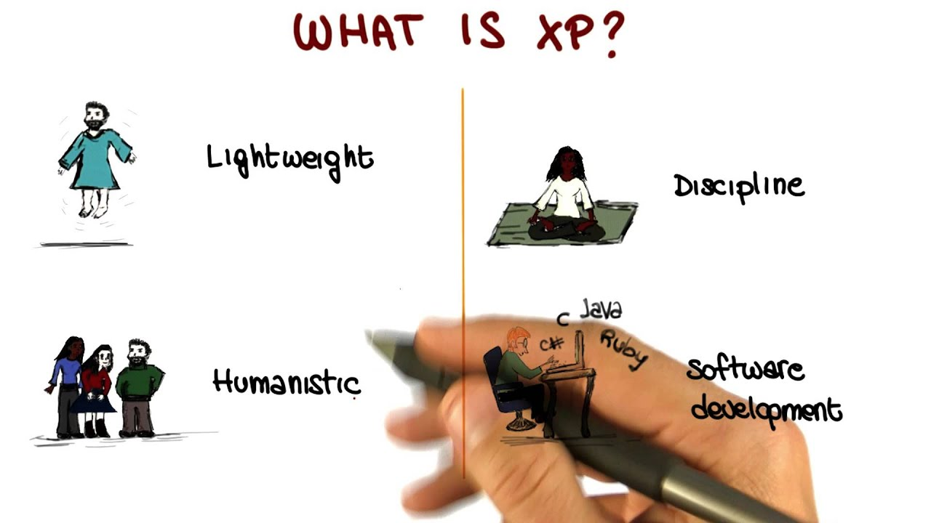
WHAT IS EXTREME PROGRAMMING?
Extreme Programming (XP) is an agile method created in the late 90's for software development.
It is a methodology whose objective is to create high quality systems, based on close interaction with customers, constant testing and short development cycles.

Slide 3

CHARACTERISTICS
Customer satisfaction
Generate continuous delivery and improvement
Prepare for changes throughout the process
Guarantee quality, even if it is in a shorter period of time
Work as a team

Slide 4
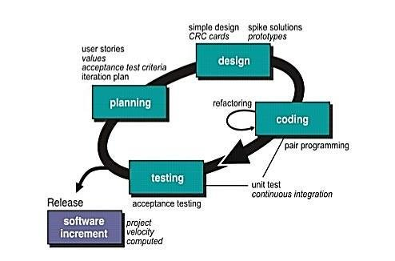
Phases of the XP methodology

Slide 5

PHASE 1: PLANNING
Based on the identification of user stories prioritized and decomposed into mini-versions. decomposed into mini-versions. The planning will be reviewed on a rolling basis. Every approximately every two weeks of iteration, a useful, functional, ready to test and software ready to be tested and released. launch.

Slide 6

PHASE 2: DESIGN
In this phase, the programming is done. We will try to make it a simple code, with the essential flow to make the user's story work and always considering the user's experience.

Slide 7
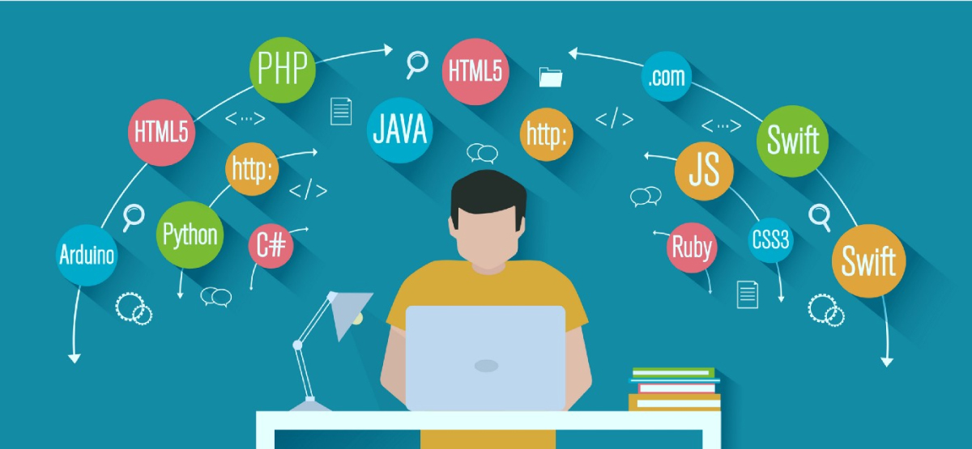
PHASE 3: CODING
The programming phase begins. This process of the extreme programming methodology is intended to be universal.

Slide 8
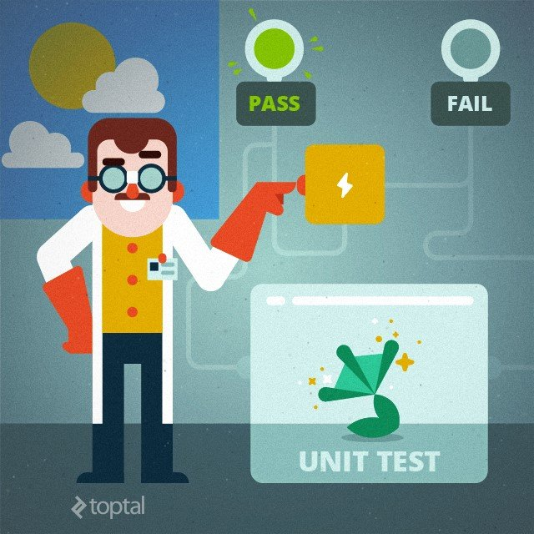
PHASE 4: TESTING
One of the characteristics of the XP methodology is constant change, so when the code of a function is ready, it is subjected to a series of continuous unit tests, with the objective of correcting faults periodically.

Slide 9

PHASE 5: LAUNCHING
The launch is undoubtedly the most anticipated moment. If the previous stages have been followed correctly, there should be no surprises.

Slide 10

How to apply the XP Methodology
Organize daily meetings.
Create task lists.
Perform collaborative work remotely.
Monitor progress.
Notify team members and maintain effective communication.

Slide 11
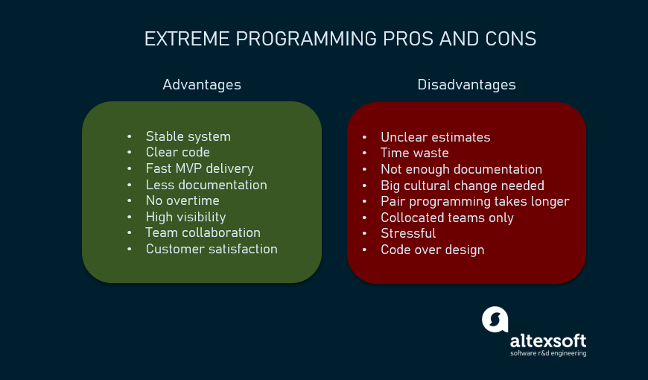

Slide 12

Equipo
Programadores
Trackers
Clientes
Testers
Coach

Slide 13
REFERENCIAS
D. (2021, 1 octubre). ¿Qué Es Extreme Programming (XP)? - Valores, Principios Y Prácticas. Digite. https://www.digite.com/es/agile/programacion-extrema-xp/
Bello, E. (2021, 29 abril). Descubre qué es el Extreme Programming y sus características. Thinking for Innovation. https://www.iebschool.com/blog/que-es-el-xp-programming-agile-scrum/
Mancuzo, G. (2022a, marzo 21). Metodología XP: La Mejor Vía para el Desarrollo de Software. Blog - ComparaSoftware. https://blog.comparasoftware.com/metodologia-xp/
SYDLE. (s. f.). Post title. https://www.sydle.com/blog/extreme-programming-what-is-it-and-how-does-it-work-602ee205da4d096809438c9c/

